Slide 1
ENERGY Audit - Industry
By
Ravindra M Datar
Senergy Consultants (P) Ltd
91-9821271630
ravi@senergy.co.in
www.senergy-india.com

Slide 2
Senergy
Synergy
between
Our expertise on conservation of energy
&
Your experience & knowledge of
process, operations, plant engineering, etc.
To
Save Energy
Notes:
Determine the best close for your audience and your presentation. Close with a summary; offer options; recommend a strategy; suggest a plan; set a goal. Keep your focus throughout your presentation, and you will more likely achieve your purpose.

Slide 3
Senergy
Leading Energy Conservation Consultants in India
Conducting Energy Conservation Studies for past 27 years.
Team of experts headed by a technocrat from IIT
Customer driven company with many repeat orders & orders form group companies
Among of the first to receive ISO 9001-2000 certification.
Lead Auditor ISO 50001, Energy Management System
Notes:
In your opening, establish the relevancy of the topic to the audience. Give a brief preview of the presentation and establish value for the listeners. Take into account your audience’s interest and expertise in the topic when choosing your vocabulary, examples, and illustrations. Focus on the importance of the topic to your audience, and you will have more attentive listeners.

Slide 4
Senergy
Empanelled with Maharashtra & Gujarat Governments (MEDA & GEDA)
BEE Certified & Accredited Auditors
Over 1,200 clients in diversified fields including Power Plants, Ferrous & non-ferrous, Chemical, Pharmaceutical, Textile, Pulp & Paper, Engineering, Automobiles, Hotels, Hospitals & Commercial Premises
Instrumental towards energy saving of Rs 100 crores/year
Notes:
In your opening, establish the relevancy of the topic to the audience. Give a brief preview of the presentation and establish value for the listeners. Take into account your audience’s interest and expertise in the topic when choosing your vocabulary, examples, and illustrations. Focus on the importance of the topic to your audience, and you will have more attentive listeners.

Slide 5
Senergy
Interactive studies.
Practical & Realistic Suggestions.
Turnkey Consultancy during Implementation.
Long term services for Sustainable Savings & Continuous Improvements.
Basic & Advanced Training Programs.
Notes:
In your opening, establish the relevancy of the topic to the audience. Give a brief preview of the presentation and establish value for the listeners. Take into account your audience’s interest and expertise in the topic when choosing your vocabulary, examples, and illustrations. Focus on the importance of the topic to your audience, and you will have more attentive listeners.

Slide 6
Few of our clients
Hindustan Zinc Ltd
Sterlite Industries Ltd
Grasim Industries Ltd
Excel Industries Ltd
Century Enka Ltd
Century Rayon
Asian Heart Hospital
Essel World
EBG India Pvt Ltd
Sandoz Ltd
Wartsila Industries Ltd
PepsiCo India Ltd
USV Ltd
Jindal Saw Ltd
United Nations Industrial Development Organization – UNIDO Allana Industries Ltd
Tata Chemicals Ltd
Schenectady Herdillia ltd
Hindustan Lever Ltd
Nicolas Piramal India Ltd
NOCIL Ltd
DGP Hinoday Ltd
Tata Metalliks Ltd
Ultratech Ltd
Whirlpool of India Ltd
Pidilite Industries Ltd
Sachivalay – Gujarat
Wockhardt Ltd
Clarient Chemicals (India) Ltd
Notes:
In your opening, establish the relevancy of the topic to the audience. Give a brief preview of the presentation and establish value for the listeners. Take into account your audience’s interest and expertise in the topic when choosing your vocabulary, examples, and illustrations. Focus on the importance of the topic to your audience, and you will have more attentive listeners.

Slide 7
Instruments
Ultrasonic non-contact type flow meters for liquid
Ultrasonic non-contact type Energy (kCal/hr, TR) flow meter for liquid
Power & Harmonic analyzers
Clamp-on type power / energy meters
Thermal Imager
Anemometers – to measure velocity of gases
Digital Manometers & Pressure Gauges
Digital thermometers for liquid / surface temperature
Environment Meter for Lux, Temperature, RH, Sound & CO₂
Combustion Gas Analyzer
Pressure Gauges
Digital Hygro-temp Meter (for Temp & RH measurement)

Slide 8
Energy Audit – Coverage
Analysis of specific energy consumption
overall
Analysis of energy bill – electricity & fuel
Energy & Mass Balance for
Furnaces
Ovens
Boilers
Performance of
Pumps
Fans & Blowers
Compressors
Cooling Tower
refrigeration Compressors
Air Conditioning Systems
Notes:
Determine the best close for your audience and your presentation. Close with a summary; offer options; recommend a strategy; suggest a plan; set a goal. Keep your focus throughout your presentation, and you will more likely achieve your purpose.

Slide 9
Energy Audit – Coverage
Motor Load Study
Study of distribution system
Cable Losses
Water
Power Quality & Harmonic Analysis
Brain storming & joint analysis of proposals
Energy Awareness & Training (Duration - 3 to 4 hours)
Identification of potential saving areas
Suggestions & Recommendation
Report & Final Presentation
Notes:
Determine the best close for your audience and your presentation. Close with a summary; offer options; recommend a strategy; suggest a plan; set a goal. Keep your focus throughout your presentation, and you will more likely achieve your purpose.

Slide 10
Specific Energy Consumption
Specific Energy: Energy consumed per unit output.
It is the Key performance assessment tool for every energy consumer.
Collect the following data on monthly basis & for last 12 month
Total production
Power consumption – SEB & Captive
Consumption of each type of fuel
Cost of each type of fuel
Notes:
Determine the best close for your audience and your presentation. Close with a summary; offer options; recommend a strategy; suggest a plan; set a goal. Keep your focus throughout your presentation, and you will more likely achieve your purpose.

Slide 11
Specific Energy Consumption
Outcome savings / gains through
Operational improvements
Effective monitoring
Streamlining production / Operations
Notes:
Determine the best close for your audience and your presentation. Close with a summary; offer options; recommend a strategy; suggest a plan; set a goal. Keep your focus throughout your presentation, and you will more likely achieve your purpose.

Slide 12
Specific Energy Consumption
Notes:
Determine the best close for your audience and your presentation. Close with a summary; offer options; recommend a strategy; suggest a plan; set a goal. Keep your focus throughout your presentation, and you will more likely achieve your purpose.

Slide 13
Energy & Mass Balance
Mass Balance
Mass can neither be created nor destroyed, but for fusion or fission reactions.
Input Material = Output Material
Energy Balance
Energy can neither be created nor destroyed, but for fusion or fission reactions.
Input Energy = Output Energy
Outcome
Clear idea about potential saving / gain areas
Notes:
Determine the best close for your audience and your presentation. Close with a summary; offer options; recommend a strategy; suggest a plan; set a goal. Keep your focus throughout your presentation, and you will more likely achieve your purpose.

Slide 14
Energy & Mass Balance Engine - Furnace Oil Fired
Description | Consumption
 | MJ/hr | %
Input Energy - FO | 46183 | 100.0%
Power | 19982 | 43.3%
Steam | 5565 | 12.0%
Hot Water - VAM | 6688 | 14.5%
Flue Gas | 6948 | 15.0%
Hot Water - Atmosphere | 4820 | 10.4%
Miscellaneous | 2181 | 4.7%
Notes:
Determine the best close for your audience and your presentation. Close with a summary; offer options; recommend a strategy; suggest a plan; set a goal. Keep your focus throughout your presentation, and you will more likely achieve your purpose.

Slide 15
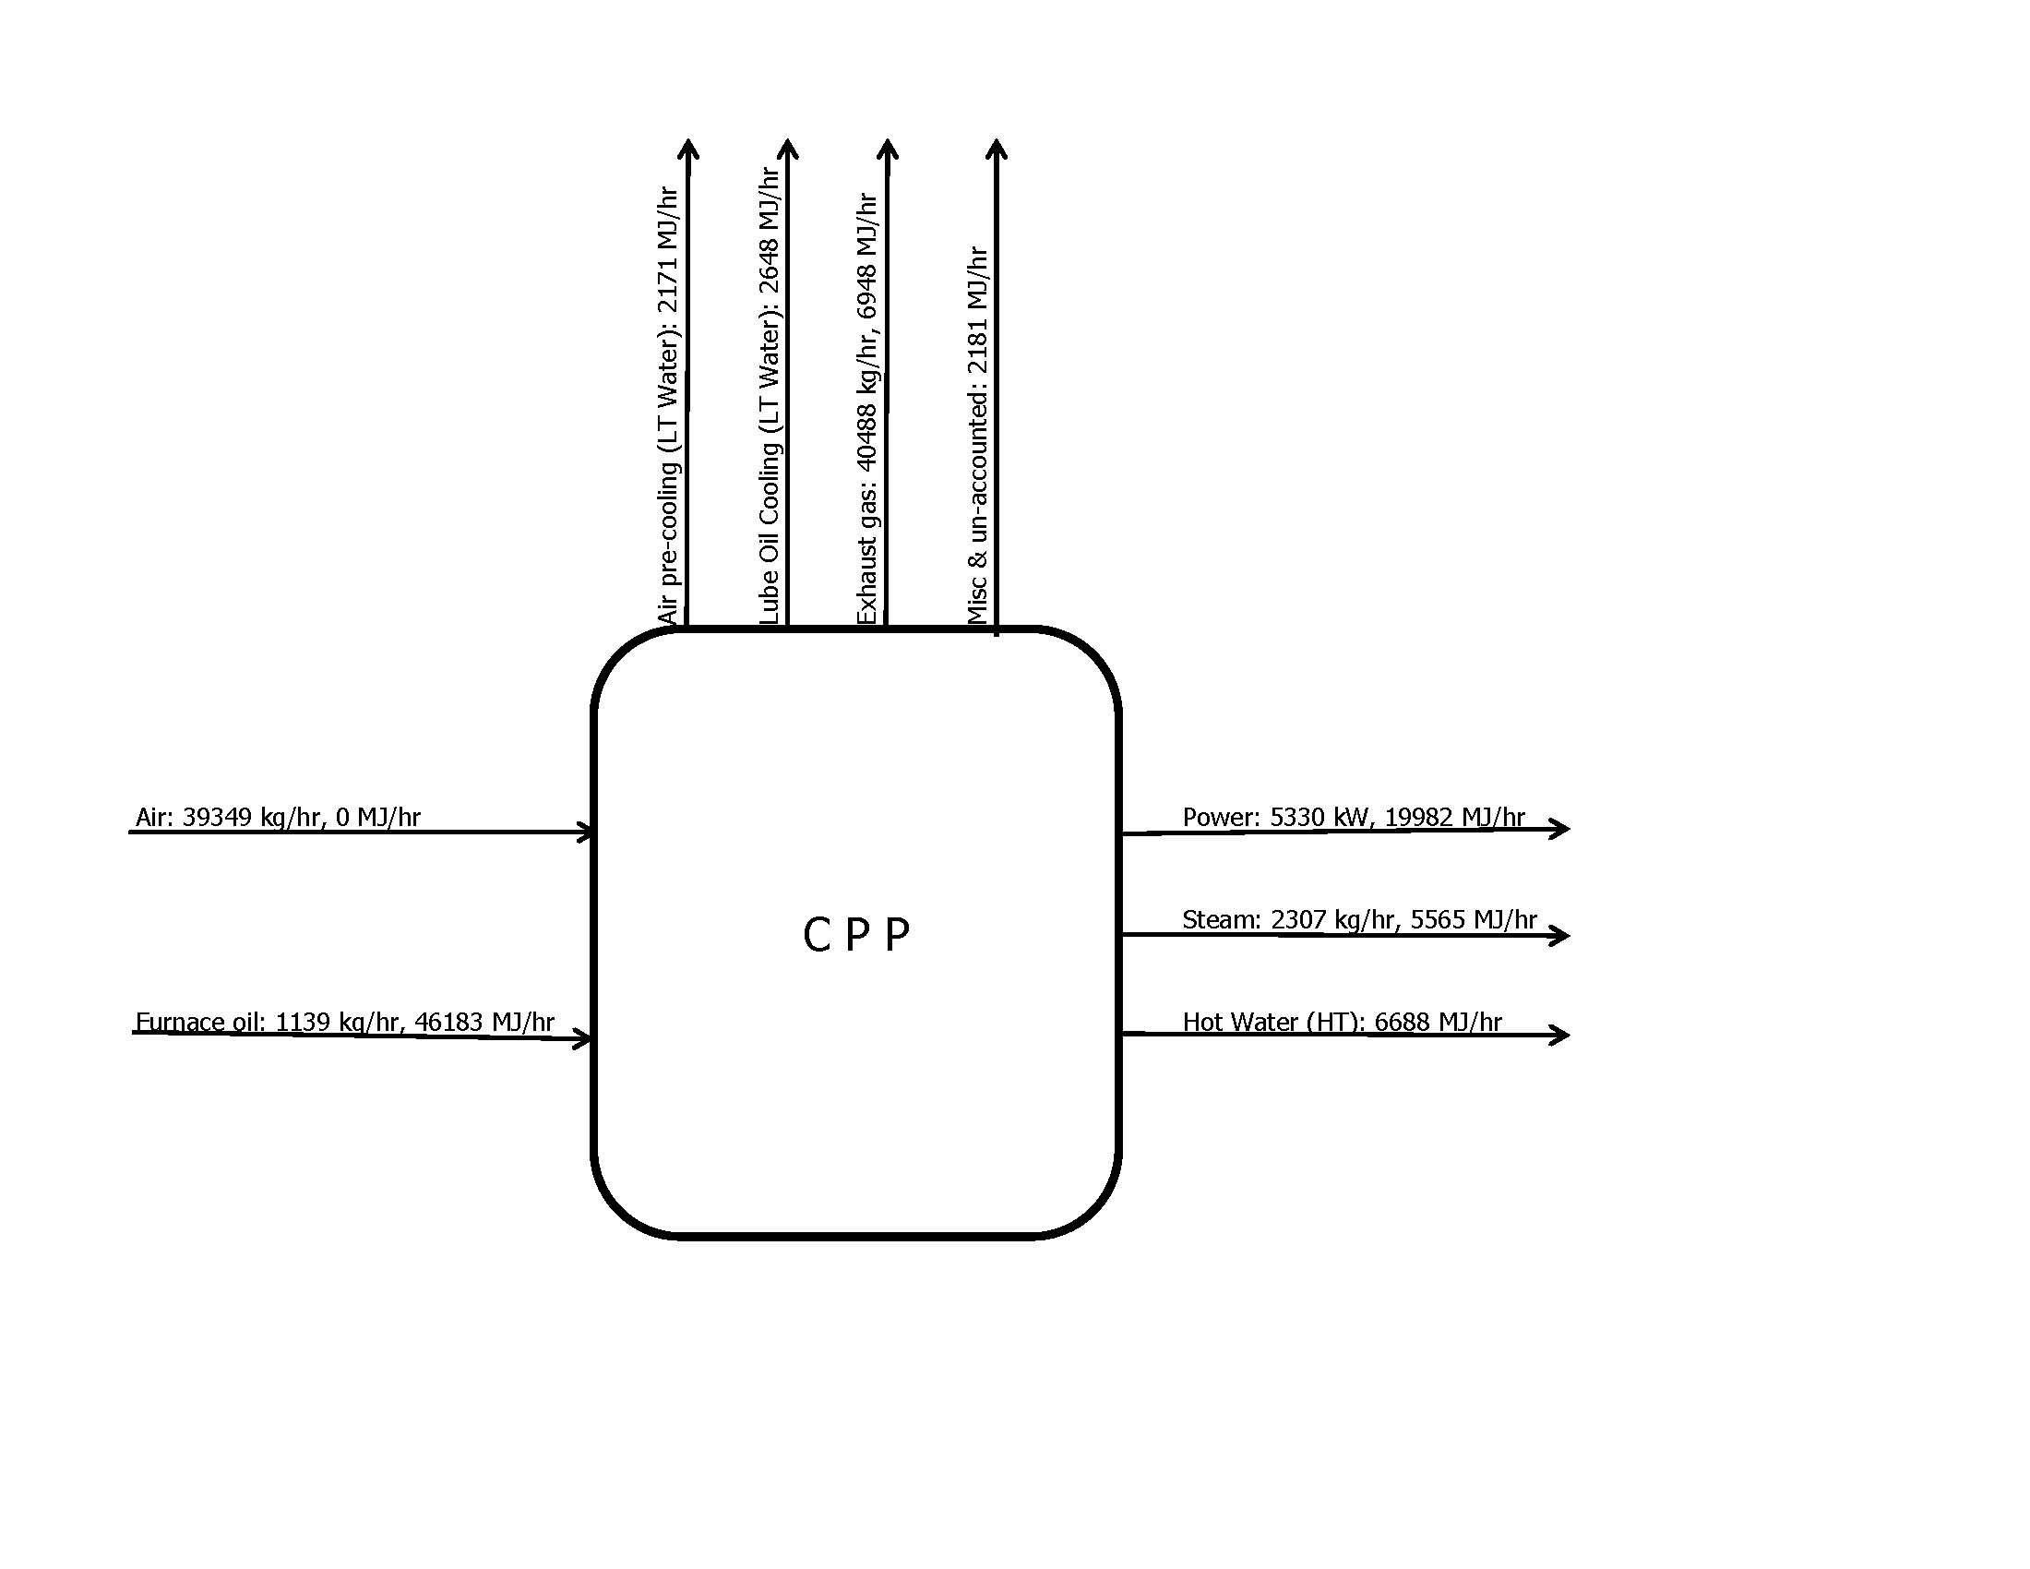
Energy & Mass Balance
Notes:
Determine the best close for your audience and your presentation. Close with a summary; offer options; recommend a strategy; suggest a plan; set a goal. Keep your focus throughout your presentation, and you will more likely achieve your purpose.

Slide 16
Energy Accounting / Balancing

Slide 17
Analysis of Energy Bills
Electricity Bill
Power Factor
Load Factor
Time of Day
Demand Management
Fuel Bill
Possibility of replacing cheaper source of energy
Combined Heat & Power (Cogeneration) Systems
Outcome
Optimizing purchase cost of energy
Notes:
Determine the best close for your audience and your presentation. Close with a summary; offer options; recommend a strategy; suggest a plan; set a goal. Keep your focus throughout your presentation, and you will more likely achieve your purpose.

Slide 18
Power Quality & Harmonic Analysis
Logging of electrical parameters of individual phases
Voltage, Current, Power Factor and Power – real, active and reactive
Current harmonics – Total (THD) as well as 3rd , 5th, up to 23rd
Voltage harmonics – Total (THD) as well as 3rd , 5th, up to 23rd
Outcome
Phase Imbalance in electrical parameters including current, voltage
Harmonic distortion in current as well as voltage wave forms
Loading profile over a period of time
The purpose is to identify power quality and harmonic issues; the correct actions would improve power quality but may not necessarily result in energy saving.
Notes:
Determine the best close for your audience and your presentation. Close with a summary; offer options; recommend a strategy; suggest a plan; set a goal. Keep your focus throughout your presentation, and you will more likely achieve your purpose.

Slide 19
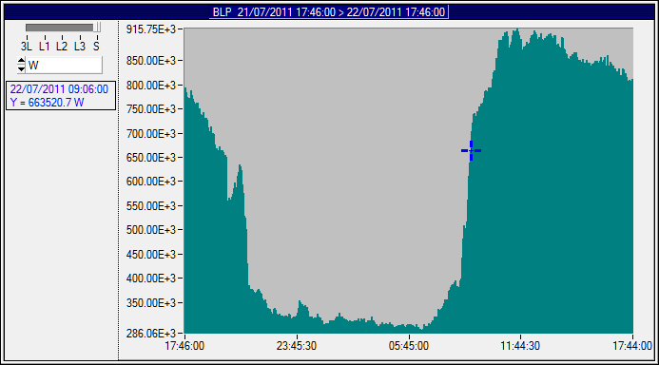
Consumption Profile – 24 hr
Notes:
Determine the best close for your audience and your presentation. Close with a summary; offer options; recommend a strategy; suggest a plan; set a goal. Keep your focus throughout your presentation, and you will more likely achieve your purpose.

Slide 20
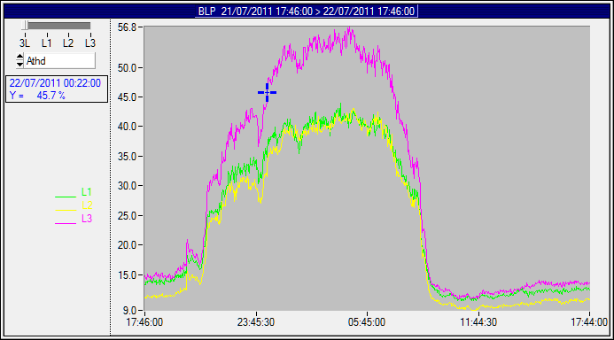
Current Harmonics - Total
Notes:
Determine the best close for your audience and your presentation. Close with a summary; offer options; recommend a strategy; suggest a plan; set a goal. Keep your focus throughout your presentation, and you will more likely achieve your purpose.

Slide 21
Thermal Imaging of Electrical System
Measure
Temperature profile of electrical panels / connections with Thermal Imager Camera
Outcome
Identification of Hot Spots
The purpose is to identify hot spot due to localized heating; which could lead to failure / accidents. The correct actions would ensure safe operation but may not necessarily result in energy saving.
Notes:
Determine the best close for your audience and your presentation. Close with a summary; offer options; recommend a strategy; suggest a plan; set a goal. Keep your focus throughout your presentation, and you will more likely achieve your purpose.

Slide 22
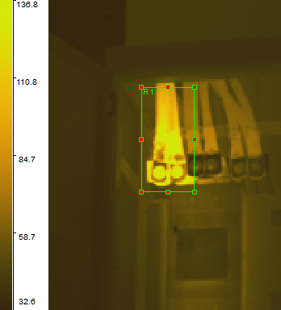
Thermal Imaging of Electrical System
Label | Max Value | Min Value | Average Value
R1 | 210.2°C | 44.3°C | 91.8°C
Notes:
Determine the best close for your audience and your presentation. Close with a summary; offer options; recommend a strategy; suggest a plan; set a goal. Keep your focus throughout your presentation, and you will more likely achieve your purpose.

Slide 23
Motors
Measure
Operating parameters like Voltage, Current, Power Factor and Power
Note down Motor Rating, Efficiency, type of Application and Operating Period
Outcome
Load / Loading Pattern of the motors
Expected drop in Efficiency at operating load
Steps to optimize motor performance
Potential saving with cost benefit analysis
Notes:
Determine the best close for your audience and your presentation. Close with a summary; offer options; recommend a strategy; suggest a plan; set a goal. Keep your focus throughout your presentation, and you will more likely achieve your purpose.

Slide 24
Motors
Equipment | Rating | Power | Voltage | Current | P F | Load
 | kW | kW | V | A |  | %
Compressor - Air | 1020 | 911 | 10970 | 53 | 0.91 | 89%
Blower – RAB | 1200 | 717 | 10970 | 43 | 0.87 | 60%
Blower - SO2 | 2800 | 1954 | 10890 | 117 | 0.88 | 70%
Pump - Boiler Circulation | 220 | 196 | 3390 | 40 | 0.82 | 89%
Pump - Boiler Feed Water | 200 | 153 | 3390 | 29 | 0.89 | 77%
Compressor - Zinc Dust L | 500 | 434 | 3390 | 94.7 | 0.78 | 87%
Blower - Zinc Dust | 150 | 51 | 425 | 133 | 0.52 | 36%
Pump - Filter Water Supply | 125 | 85 | 425 | 137 | 0.87 | 68%
Compressor - JK 01 – 5 | 200 | 171 | 417 | 268 | 0.87 | 86%
Blower - Hot Air | 200 | 68 | 417 | 157 | 0.6 | 34%
Fan - Cooling Air | 132 | 69 | 408 | 120 | 0.8 | 52%
Ball Mill | 180 | 150 | 421 | 260 | 0.8 | 83%
Notes:
Determine the best close for your audience and your presentation. Close with a summary; offer options; recommend a strategy; suggest a plan; set a goal. Keep your focus throughout your presentation, and you will more likely achieve your purpose.

Slide 25
Pumps
Measure
Velocity of liquid to determine flow rate
Differential Pressure
Power drawn by motor
Note down Motor Efficiency and Specific gravity of Liquid
Outcome
Present pump efficiency
Operating parameters – Flow, differential head and power.
Recommended Efficiency at Operating parameters
Steps to achieve the recommended parameters
Potential saving with cost benefit analysis
Notes:
Determine the best close for your audience and your presentation. Close with a summary; offer options; recommend a strategy; suggest a plan; set a goal. Keep your focus throughout your presentation, and you will more likely achieve your purpose.

Slide 26
Pumps
Description | Units | WC-1 - M-1 | WC-1 - M-2 | WC-1 - M-3 | WC-1 - M-4
Actual Parameters
Cost of Power | Rs/kWh | 2.56 | 2.56 | 2.56 | 2.56
Operation | Hr/day | 24 | 24 | 24 | 24
 | Day/Year | 360 | 360 | 360 | 360
Flow rate | M3/hr | 878 | 917 | 865 | 898
Differential Head | M | 33 | 33 | 34 | 33
Motor Power | kW | 140 | 124 | 155 | 145
Pump Efficiency | % | 63% | 74% | 57% | 62%
Recommended Parameters
Head | M | 34 | 34 | 34 | 34
Flow rate | M3/hr | 900 | 900 | 900 | 900
Pump Efficiency | % | 85% | 85% | 85% | 85%
Shaft Power | Bkw | 98.1 | 98.1 | 98.1 | 98.1
Motor Power | kW | 109.0 | 109.0 | 109.0 | 109.0
Economics
Loss | kW | 31.0 | 15.0 | 46.0 | 36.0
 | kWh/year | 267911 | 129671 | 397511 | 311111
 | Rs/year | 685851 | 331957 | 1017627 | 796443
Notes:
Determine the best close for your audience and your presentation. Close with a summary; offer options; recommend a strategy; suggest a plan; set a goal. Keep your focus throughout your presentation, and you will more likely achieve your purpose.

Slide 27
Refrigeration Compressors
Measure
Velocity of liquid to determine flow rate through chiller
Differential Temperature across chiller
Power drawn by compressor motor
Note down Motor Efficiency, Specific gravity and Specific heat of Liquid, Speed of Compressor
Outcome
Operating capacity & Specific Power Consumption
Recommended Specific Power at operating / design parameters
Steps to achieve the recommended / design parameters
Potential saving with cost benefit analysis
Notes:
Determine the best close for your audience and your presentation. Close with a summary; offer options; recommend a strategy; suggest a plan; set a goal. Keep your focus throughout your presentation, and you will more likely achieve your purpose.

Slide 28
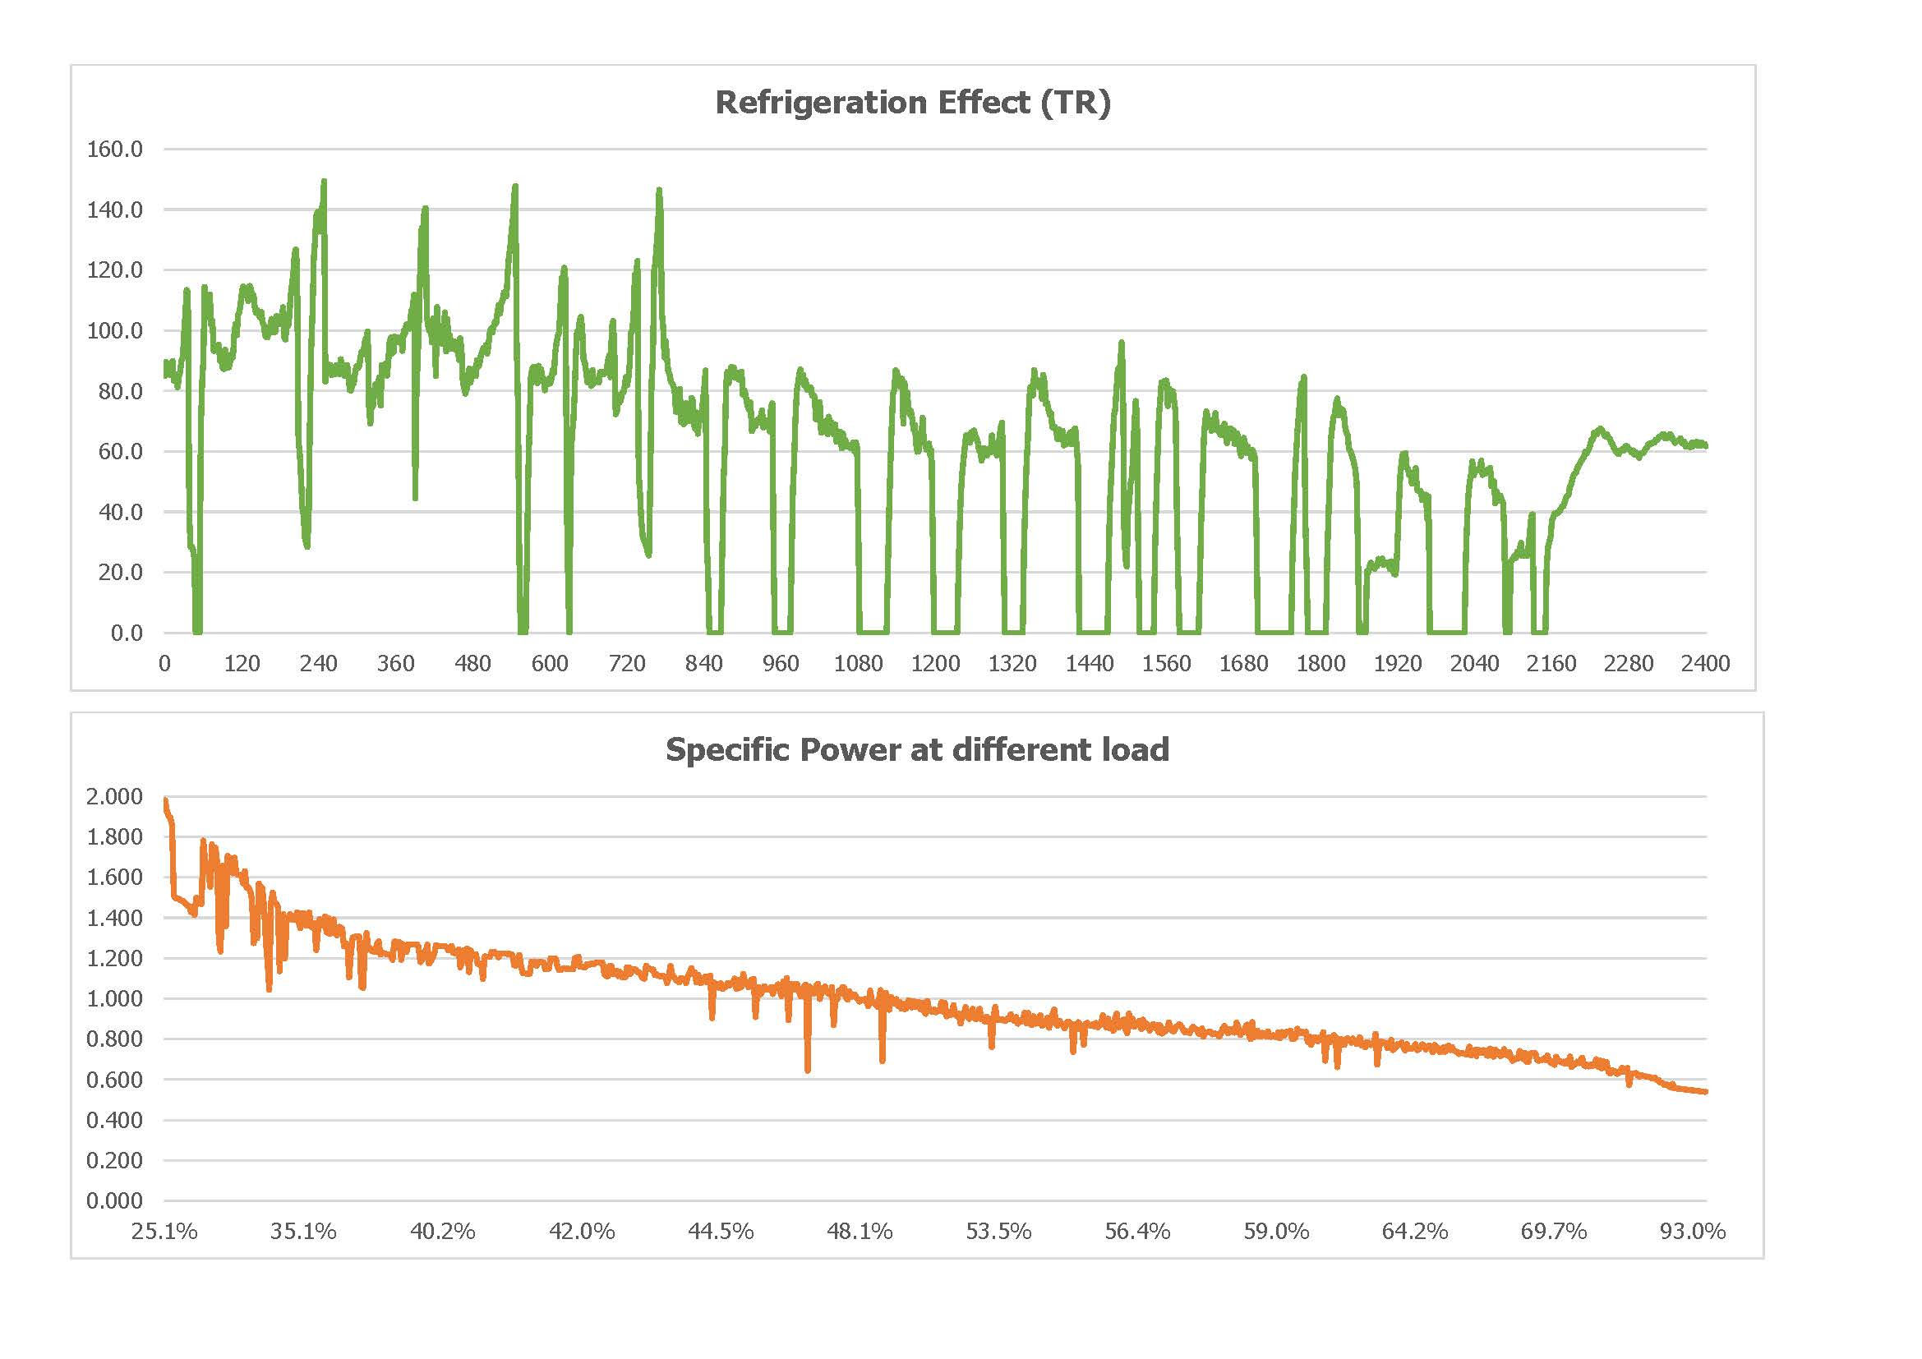
Notes:
Determine the best close for your audience and your presentation. Close with a summary; offer options; recommend a strategy; suggest a plan; set a goal. Keep your focus throughout your presentation, and you will more likely achieve your purpose.

Slide 29
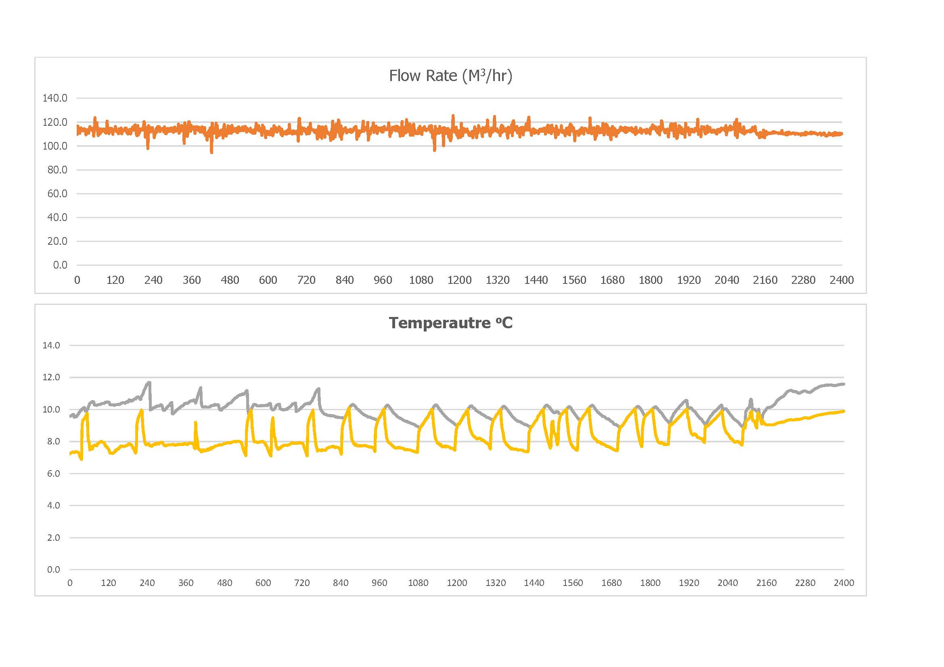
Notes:
Determine the best close for your audience and your presentation. Close with a summary; offer options; recommend a strategy; suggest a plan; set a goal. Keep your focus throughout your presentation, and you will more likely achieve your purpose.

Slide 30
Refrigeration Compressors
Sr No | Description | ChWC – 11 100 TR
1 | Start Time | January 1st, at 20:00 Hr
2 | End Time | January 2nd, at 20:00 Hr
3 | Duration | 24 Hours
4 | Inlet Temperature | 13.0 ºC
5 | Outlet Temperature | 12.2 ºC
6 | Flow Rate | 80.4 M³/hr
7 | Refrigeration Load - Maximum | 83.6 TR 83.6% of Rated
8 | Refrigeration Load - Average | 33.8 TR 33.8% of Rated
9 | Power Consumption – Average | 19.4 kW
10 | Specific Power Consumption – Average | 0.943 kWh/TR
11 | Refrigeration Compressor – On duration | 60.4%
12 | Average output of Refrigeration Compressor | 20.46 TR 20.5% of Rated

Slide 31
Fans & Blowers
Measure
Velocity of gas to determine flow rate
Differential Pressure
Power drawn by motor
Note down Motor Efficiency, Temperature and Specific gravity of gas
Outcome
Operating efficiency (Static pressure) of fan
Operating parameters – Flow, Diff Pressure & Power
Recommended Efficiency at Operating parameters
Steps to achieve the recommended parameters
Potential saving with cost benefit analysis
Notes:
Determine the best close for your audience and your presentation. Close with a summary; offer options; recommend a strategy; suggest a plan; set a goal. Keep your focus throughout your presentation, and you will more likely achieve your purpose.

Slide 32
Fans & Blowers
Description | Unit | Blower-1 | Blower-2
Actual Parameters
Flow Rate | NM³/hr | 6700 | 9000
Differential Pressure | Mm WG | 1800 | 4650
Motor Power | kW | 675.0 | 1954.0
Fan Efficiency | % | 63% | 69%
Damper Position | % Open | 40% | 60%
Desired Parameters
Flow Rate | NM³/hr | 6700 | 9000
Differential Pressure | Mm WG | 1800 | 4650
Fan Efficiency | % | 70% | 80%
Motor Power | kW | 50.4 | 152.9
Potential Savings
Loss | kW | 1711 | 4214
 | kW/Month | 12329 | 30556
 | Rs/Month | 3,13,00 | 77600
Notes:
Determine the best close for your audience and your presentation. Close with a summary; offer options; recommend a strategy; suggest a plan; set a goal. Keep your focus throughout your presentation, and you will more likely achieve your purpose.

Slide 33
Air Compressors Capacity Test
Isolate compressor & receiver from the system.
Close the outlet valve of the receiver.
Switch off the compressor.
Vent the air to bring down the pressure to atmospheric.
Start the compressor.
Note down the final pressure and the time required to reach the final pressure.
Measure power consumption of the compressor at the final pressure.
Measure volume of the receiver and the piping till the receiver.
Indicative Method:
Measure suction flow rate with anemometer & note down area of air flow.
Notes:
Determine the best close for your audience and your presentation. Close with a summary; offer options; recommend a strategy; suggest a plan; set a goal. Keep your focus throughout your presentation, and you will more likely achieve your purpose.

Slide 34
Air Compressors Leak Test / Operating Load Test
Operating Load:
Note down overall load time and operating time of the compressors during the specified period.
Leak Test:
Switch off all the consumers of compressed air.
Operate optimum number of compressors.
Note down the total time of the test and the loading time of the individual air compressors.
Note down power consumption loading and un-loading of the individual compressors.
Notes:
Determine the best close for your audience and your presentation. Close with a summary; offer options; recommend a strategy; suggest a plan; set a goal. Keep your focus throughout your presentation, and you will more likely achieve your purpose.

Slide 35
Air Compressors
Outcome
Operating capacity
Specific Power Consumption
Recommended Specific Power at operating / design parameters
Leakages in the system
Loading pattern on the compressor
Steps to achieve the recommended / design parameters
Potential saving with cost benefit analysis
Notes:
Determine the best close for your audience and your presentation. Close with a summary; offer options; recommend a strategy; suggest a plan; set a goal. Keep your focus throughout your presentation, and you will more likely achieve your purpose.

Slide 36
Air Compressors capacity Test
Description | Unit | Auxiliary Module | Shot Blasting | Gear Box | Recron
Model |  | E-37-7.5 | E-18-7.5 | E-22-7.5 | E-18-7.5
Make |  | Elgi | Elgi | Elgi | Elgi
Capacity | M³/hr | 382.5 | 178.5 | 212.5 | 178.5
 | CFM | 225 | 105 | 125 | 105
Rated Pressure | Kg/cm² | 7 | 7 | 7 | 7
Actual Pressure | Kg/cm² | 6 | 6.2 | 6.4 | 6
Receiver & Piping Volume | M³ | 1.05 | 1.05 | 1.05 | 1.05
Power - Load | kW | 36.3 | 18.7 | 24.9 | 17.4
Power - Un-load | kW | 9.2 | 4.6 | 7.21 | 4.9
Capacity test - Time to fill Receiver | Sec | 64 | 132 | 168 | 136
Operating Capacity | M³/hr | 354.4 | 177.5 | 144.4 | 166.8
Specific Power | kW/M³ | 0.102 | 0.105 | 0.172 | 0.104
Notes:
Determine the best close for your audience and your presentation. Close with a summary; offer options; recommend a strategy; suggest a plan; set a goal. Keep your focus throughout your presentation, and you will more likely achieve your purpose.

Slide 37
Air Compressors Operating Load
Description | Unit | Compressed Air
 |  | LP | HP
Loading Period | Hr/day | 56.0 | 16.0
Loading Period | Hr/day | 16.0 | 8.0
Utilization | % total | 78% | 67%
Load Power | kW | 170.8 | 157.5
Unload Power | kW | 33.5 | 34.5
Consumption | kWh/day | 10100 | 2800
Useful Power | kWh/day | 9564 | 2525
Unload Losses | kWh/day | 536 | 275
Total Air | M³/day | 106272 | 22956
 | M³/hr | 4428 | 956
 | CFM | 2605 | 563
Notes:
Determine the best close for your audience and your presentation. Close with a summary; offer options; recommend a strategy; suggest a plan; set a goal. Keep your focus throughout your presentation, and you will more likely achieve your purpose.

Slide 38
Air Compressors Leak Test
Description | Unit | Low Pressure System (7.0 kg/cm²_{g})
 |  | CP-1 | CP-3
Design Flow Rate | CFM | 1100 | 1100
 | M³/Hr | 1870 | 1870
Design Pressure | Kg/Cm²_{g} | 7.0 | 7.0
Operating Pressure | Kg/Cm²_{g} | 7.0 | 7.0
Motor Input Power | kW | 162 | 180
Loading Time | Sec | 100 | 64.05
Unloading Time | Sec | 0 | 349
Losses due to leakages | M³/Hr | 1870 | 290
 | kW | 162.0 | 27.9
 | % Total | 100% | 16%
Notes:
Determine the best close for your audience and your presentation. Close with a summary; offer options; recommend a strategy; suggest a plan; set a goal. Keep your focus throughout your presentation, and you will more likely achieve your purpose.

Slide 39
Cooling Towers
Measure (during a specified period of time)
Air velocity to determine air flow rate for each cell
Ambient Conditions - DBT, WBT
Inlet and outlet temperature of water
Range and Approach
Power drawn by Fan
Outcome
Operating parameters - Output, Effectiveness , L/G Ratio
Recommended Operating parameters
Steps to achieve the recommended parameters
Potential saving with cost benefit analysis
Notes:
Determine the best close for your audience and your presentation. Close with a summary; offer options; recommend a strategy; suggest a plan; set a goal. Keep your focus throughout your presentation, and you will more likely achieve your purpose.

Slide 40
Cooling Towers
Description | Unit | CT - 1 - 1 | CT - 1 - 2 | CT - 1 - 3
Actual Parameters
Dry bulb Temperature - Top | ºC | 31.0 | 31.0 | 31.0
Wet bulb Temperature - Top | ºC | 29.0 | 29.0 | 29.0
Dry bulb Temperature - Bottom | ºC | 30.0 | 30.0 | 30.0
Wet bulb Temperature - Bottom | ºC | 25.0 | 25.0 | 25.0
Air velocity | m/s | 7.74 | 6.3 | 6.64
Fan Diameter | M | 6.40 | 6.40 | 6.40
Air Flow Rate | kg/hr | 1075113 | 869536 | 922320
Cooling Water Temperature - Top | ºC | 37.1 | 37.1 | 37.1
Cooling Water Temperature – Sump | ºC | 30.8 | 30.8 | 30.8
Power Consumption | kW | 27.00 | 28.0 | 27
Notes:
Determine the best close for your audience and your presentation. Close with a summary; offer options; recommend a strategy; suggest a plan; set a goal. Keep your focus throughout your presentation, and you will more likely achieve your purpose.

Slide 41
Cooling Towers
Description | Unit | CT - 1 - 1 | CT - 1 - 2 | CT - 1 - 3
Overall Parameters
Cooling Water Flow Rate | M³/hr | 1186.0 | 1186.0 | 1186.0
Cooling Tower Performance | TR | 2471 | 2471 | 2471
L/G ratio |  | 1.10 | 1.36 | 1.29
Actual Range | ºC | 6.3 | 6.3 | 6.3
Actual Approach | ºC | 5.8 | 5.8 | 5.8
Cooling tower Effectiveness | % | 52% | 52% | 52%
Evaporation Losses | M³/hr | 11.43 | 11.43 | 11.43
Drift loss | M³/hr | 2.97 | 2.97 | 2.97
Water consumption | M³/hr | 14.40 | 14.40 | 14.40
Specific Power | kW/TR | 0.011 | 0.011 | 0.011
Notes:
Determine the best close for your audience and your presentation. Close with a summary; offer options; recommend a strategy; suggest a plan; set a goal. Keep your focus throughout your presentation, and you will more likely achieve your purpose.

Slide 42
Furnaces Specific Energy / Efficiency (Direct / Indirect)
Measure (during the specified period of time)
Useful Heat energy for heating the product
Total Energy supplied
Combustion gas analysis – CO₂, O₂ & Stack temp
Surface area and wall temperature
Furnace temperature & Opening
Any other sources of losses
Outcome
Operating efficiency by direct & indirect method
Losses with quantification from individual avenue
Recommended parameters & steps to achieve them
Potential saving with cost benefit analysis
Notes:
Determine the best close for your audience and your presentation. Close with a summary; offer options; recommend a strategy; suggest a plan; set a goal. Keep your focus throughout your presentation, and you will more likely achieve your purpose.

Slide 43
Illumination & Indoor Air Quality
Illumination Level
Temperature
Relative Humidity (RH)
Carbon dioxide (CO₂) contents
Notes:
Determine the best close for your audience and your presentation. Close with a summary; offer options; recommend a strategy; suggest a plan; set a goal. Keep your focus throughout your presentation, and you will more likely achieve your purpose.

Slide 44
Notes:
Determine the best close for your audience and your presentation. Close with a summary; offer options; recommend a strategy; suggest a plan; set a goal. Keep your focus throughout your presentation, and you will more likely achieve your purpose.

Slide 45
Notes:
Determine the best close for your audience and your presentation. Close with a summary; offer options; recommend a strategy; suggest a plan; set a goal. Keep your focus throughout your presentation, and you will more likely achieve your purpose.

Slide 46
Notes:
Determine the best close for your audience and your presentation. Close with a summary; offer options; recommend a strategy; suggest a plan; set a goal. Keep your focus throughout your presentation, and you will more likely achieve your purpose.

Slide 47
Notes:
Determine the best close for your audience and your presentation. Close with a summary; offer options; recommend a strategy; suggest a plan; set a goal. Keep your focus throughout your presentation, and you will more likely achieve your purpose.

Slide 48
Notes:
Determine the best close for your audience and your presentation. Close with a summary; offer options; recommend a strategy; suggest a plan; set a goal. Keep your focus throughout your presentation, and you will more likely achieve your purpose.

Slide 49
Study of Distribution System Energy loss / Heat ingress / Leakages
Cooling water system
Pressure drop
Compressed air system
Pressure drop
Leakages
Electrical distribution system
Cable losses
Transformers
Capacitors
Notes:
Determine the best close for your audience and your presentation. Close with a summary; offer options; recommend a strategy; suggest a plan; set a goal. Keep your focus throughout your presentation, and you will more likely achieve your purpose.

Slide 50
Utilization
Over / Under Sized Equipment
Pumps, refrigeration compressors, cooling towers
High Grade Energy for Low Grade Applications
Compressed air for cleaning, brine in place of chilled water
Unwarranted & Rigid Specifications.
Stringent hall Conditions, air conditioning / lighting in unoccupied area

Slide 51
Recovery of Waste Energy
Recovery from Hot / Cold Effluent

Slide 52
Cost of Energy
Avail Maximum Tariff Concessions & Benefits
Unity PF, Night Operation, Bulk Discount, Bulk Purchases
Switchover to cheaper Fuel
Electrical to fuel (LPG / HSD / Biofuel) heating / solar system, heat pump and/or de-superheater for hot water
Power Exchange
Procuring power through power exchange

Slide 53
Thank
You!

